Slide 1
Building Java Programs
Chapter 11
Sets and Maps
reading: 11.2 - 11.3

Slide 2
Exercise
Write a program that counts the number of unique words in a large text file (say, Moby Dick or the King James Bible).
Store the words in a collection and report the # of unique words.
Once you've created this collection, allow the user to search it to see whether various words appear in the text file.
What collection is appropriate for this problem?

Slide 3
Sets (11.2)
set: A collection of unique values (no duplicates allowed) that can perform the following operations efficiently:
add, remove, search (contains)
We don't think of a set as having indexes; we just add things to the set in general and don't worry about order
"the"
"of"
"if"
set.contains("to")
"to"
"down"
"from"
true
"by"
"she"
set.contains("be")
"you"
false
"in"
"why"
"him"
set

Slide 4
Set methods
In Java, Set is an interface that allows you to call the following methods
add(value) | adds the given value to the set
contains(value) | returns true if the given value is found in this set
remove(value) | removes the given value from the set
clear() | removes all elements of the set
size() | returns the number of elements in list
isEmpty() | returns true if the set's size is 0
toString() | returns a string such as "[3, 42, -7, 15]"

Slide 5
Set implementation
in Java, sets are represented by Set type in java.util
Set is implemented by HashSet and TreeSet classes
HashSet: implemented using a "hash table" array; very fast: O(1) for all operations elements are stored in unpredictable order
TreeSet: implemented using a "binary search tree"; pretty fast: O(log N) for all operations elements are stored in sorted order
Set<Integer> numbers = new TreeSet<Integer>();
Set<String> words = new HashSet<String>();

Slide 6
The "for each" loop (7.1)
for (type name : collection) {
statements;
}
Provides a clean syntax for looping over the elements of a Set, List, array, or other collection
Set<Double> grades = new HashSet<Double>();
...
for (double grade : grades) {
System.out.println("Student's grade: " + grade);
}
needed because sets have no indexes; can't get element i

Slide 7
Exercise
Write a program to count the number of occurrences of each unique word in a large text file (e.g. Moby Dick ).
Allow the user to type a word and report how many times that word appeared in the book.
Report all words that appeared in the book at least 500 times, in alphabetical order.
What collection is appropriate for this problem?

Slide 8
Maps (11.3)
map: Holds a set of key-value pairs, where each key is unique a.k.a. "dictionary", "associative array", "hash"
key | value
"at" | 43
map.get("the")
key | value
"you" | 22
key | value
"in" | 37
key | value
"why" | 14
key | value
"me" | 22
56
key | value
"the" | 56
set

Slide 9
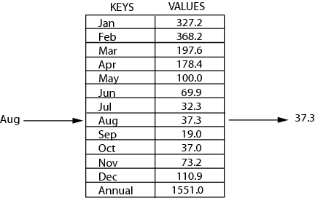
Maps (11.3)
map: Holds a set of unique keys and a collection of values, where each key is associated with one value.
a.k.a. "dictionary", "associative array", "hash"
basic map operations:
put(key, value ): Adds a mapping from a key to a value.
get(key ): Retrieves the value mapped to the key.
remove(key ): Removes the given key and its mapped value.
myMap.get("Aug") returns 37.3

Slide 10
Maps and tallying
a map can be thought of as generalization of a tallying array
the "index" (key) doesn't have to be an int
count digits: 22092310907
// (C)hocolate, (V)anilla, (S)trawberry
count votes: ”CVVVVVVCCCCCVVVVVVCVCCSCVCCSCVCCSV"
index | 0 | 1 | 2 | 3 | 4 | 5 | 6 | 7 | 8 | 9
value | 3 | 1 | 3 | 0 | 0 | 0 | 0 | 1 | 0 | 2
key | ”C" | ”V" | "S"
value | 16 | 14 | 3

Slide 11
Map implementation
in Java, maps are represented by Map type in java.util
Map is implemented by the HashMap and TreeMap classes
HashMap: implemented using an array called a "hash table"; extremely fast: O(1) ; keys are stored in unpredictable order
TreeMap: implemented as a linked "binary tree" structure; very fast: O(log N) ; keys are stored in sorted order
LinkedHashMap: O(1) ; keys are stored in order of insertion
Maps require 2 type params: one for keys, one for values.
// maps from String keys to Integer values
Map<String, Integer> votes = new HashMap<String, Integer>();
// maps from Integer keys to String values
Map<Integer, String> words = new TreeMap<Integer, String>();

Slide 12
Map methods
put(key, value) | adds a mapping from the given key to the given value; if the key already exists, replaces its value with the given one
get(key) | returns the value mapped to the given key (null if not found)
containsKey(key) | returns true if the map contains a mapping for the given key
remove(key) | removes any existing mapping for the given key
clear() | removes all key/value pairs from the map
size() | returns the number of key/value pairs in the map
isEmpty() | returns true if the map's size is 0
toString() | returns a string such as "{a=90, d=60, c=70}"
keySet() | returns a set of all keys in the map
values() | returns a collection of all values in the map
putAll(map) | adds all key/value pairs from the given map to this map
equals(map) | returns true if given map has the same mappings as this one

Slide 13
Using maps
A map allows you to get from one half of a pair to the other.
Remembers one piece of information about every index (key).
Later, we can supply only the key and get back the related value:
Allows us to ask: What is Suzy's phone number?
// key value
put("Suzy", "206-685-2181")
Map
get("Suzy")
Map
"206-685-2181"

Slide 14
keySet and values
keySet method returns a Set of all keys in the map
can loop over the keys in a foreach loop
can get each key's associated value by calling get on the map
Map<String, Integer> ages = new TreeMap<String, Integer>();
ages.put("Marty", 19);
ages.put("Geneva", 2); // ages.keySet() returns Set<String>
ages.put("Vicki", 57);
for (String name : ages.keySet()) { // Geneva -> 2
int age = ages.get(name); // Marty -> 19
System.out.println(name + " -> " + age); // Vicki -> 57
}
values method returns a collection of all values in the map
can loop over the values in a foreach loop
no easy way to get from a value to its associated key(s)

Slide 15
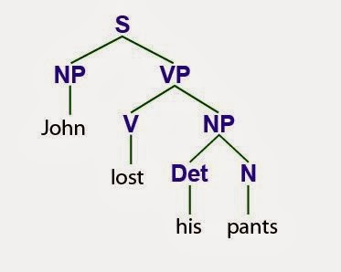

Slide 16
Languages and grammars
(formal) language: A set of words or symbols.
grammar: A description of a language that describes which sequences of symbols are allowed in that language.
describes language syntax (rules) but not semantics (meaning)
can be used to generate strings from a language, or to determine whether a given string belongs to a given language

Slide 17
Backus-Naur (BNF)
Backus-Naur Form (BNF): A syntax for describing language grammars in terms of transformation rules, of the form:
<symbol> ::= <expression> | <expression> ... | <expression>
terminal: A fundamental symbol of the language.
non-terminal: A high-level symbol describing language syntax, which can be transformed into other non-terminal or terminal symbol(s) based on the rules of the grammar.
developed by two Turing-award-winning computer scientists in 1960 to describe their new ALGOL programming language

Slide 18
An example BNF grammar
<s>::=<n> <v>
<n>::=Marty | Victoria | Stuart | Jessica
<v>::=cried | slept | belched
Some sentences that could be generated from this grammar:
Marty slept
Jessica belched
Stuart cried

Slide 19
BNF grammar version 2
<s>::=<np> <v>
<np>::=<pn> | <dp> <n>
<pn>::=Marty | Victoria | Stuart | Jessica
<dp>::=a | the
<n>::=ball | hamster | carrot | computer
<v>::=cried | slept | belched
Some sentences that could be generated from this grammar:
the carrot cried
Jessica belched
a computer slept

Slide 20
BNF grammar version 3
<s>::=<np> <v>
<np>::=<pn> | <dp> <adj> <n>
<pn>::=Marty | Victoria | Stuart | Jessica
<dp>::=a | the
<adj>::=silly | invisible | loud | romantic
<n>::=ball | hamster | carrot | computer
<v>::=cried | slept | belched
Some sentences that could be generated from this grammar:
the invisible carrot cried
Jessica belched
a computer slept
a romantic ball belched

Slide 21
Grammars and recursion
<s>::=<np> <v>
<np>::=<pn> | <dp> <adjp> <n>
<pn>::=Marty | Victoria | Stuart | Jessica
<dp>::=a | the
<adjp>::=<adj> <adjp> | <adj>
<adj>::=silly | invisible | loud | romantic
<n>::=ball | hamster | carrot | computer
<v>::=cried | slept | belched
Grammar rules can be defined recursively, so that the expansion of a symbol can contain that same symbol.
There must also be expressions that expand the symbol into something non-recursive, so that the recursion eventually ends.

Slide 22
Grammar, final version
<s>::=<np> <vp>
<np>::=<dp> <adjp> <n>|<pn>
<dp>::=the|a
<adjp>::=<adj>|<adj> <adjp>
<adj>::=big|fat|green|wonderful|faulty|subliminal
<n>::=dog|cat|man|university|father|mother|child
<pn>::=John|Jane|Sally|Spot|Fred|Elmo
<vp>::=<tv> <np>|<iv>
<tv>::=hit|honored|kissed|helped
<iv>::=died|collapsed|laughed|wept
Could this grammar generate the following sentences?
Fred honored the green wonderful child
big Jane wept the fat man fat
Generate a random sentence using this grammar.

Slide 23
Sentence generation
<s>
<np>
<vp>
<pn>
<tv>
<np>
<dp>
<adjp>
<n>
<adj>
<adjp>
<adj>
Fred
honored
the
green
wonderful
child

Slide 24
Building Java Programs
Chapter 13
Sorting
reading: 13.3, 13.4

Slide 25

Stacks, Queues, ListNodes
...

Slide 26
Collections class
Method name | Description
binarySearch(list, value) | returns the index of the given value in a sorted list (< 0 if not found)
copy(listTo, listFrom) | copies listFrom's elements to listTo
emptyList(), emptyMap(), emptySet() | returns a read-only collection of the given type that has no elements
fill(list, value) | sets every element in the list to have the given value
max(collection), min(collection) | returns largest/smallest element
replaceAll(list, old, new) | replaces an element value with another
reverse(list) | reverses the order of a list's elements
shuffle(list) | arranges elements into a random order
sort(list) | arranges elements into ascending order

Slide 27
Sorting
sorting: Rearranging the values in an array or collection into a specific order (usually into their "natural ordering").
one of the fundamental problems in computer science
can be solved in many ways:
there are many sorting algorithms
some are faster/slower than others
some use more/less memory than others
some work better with specific kinds of data
some can utilize multiple computers / processors, ...
comparison-based sorting : determining order by comparing pairs of elements:
<, >, compareTo, …

Slide 28
Sorting methods in Java
The Arrays and Collections classes in java.util have a static method sort that sorts the elements of an array/list
String[] words = {"foo", "bar", "baz", "ball"};
Arrays.sort(words);
System.out.println(Arrays.toString(words));
// [ball, bar, baz, foo]
List<String> words2 = new ArrayList<String>();
for (String word : words) {
words2.add(word);
}
Collections.sort(words2);
System.out.println(words2);
// [ball, bar, baz, foo]

Slide 29
Sorting algorithms
bogo sort: shuffle and pray
bubble sort: swap adjacent pairs that are out of order
selection sort: look for the smallest element, move to front
insertion sort: build an increasingly large sorted front portion
merge sort: recursively divide the array in half and sort it
heap sort: place the values into a sorted tree structure
quick sort: recursively partition array based on a middle value
other specialized sorting algorithms:
bucket sort: cluster elements into smaller groups, sort them
radix sort: sort integers by last digit, then 2nd to last, then ...
...

Slide 30
Selection sort
selection sort: Orders a list of values by repeatedly putting the smallest or largest unplaced value into its final position.
The algorithm:
Look through the list to find the smallest value.
Swap it so that it is at index 0.
Look through the list to find the second-smallest value.
Swap it so that it is at index 1.
...
Repeat until all values are in their proper places.

Slide 31
Selection sort example
Initial array:
After 1st, 2nd, and 3rd passes:
index | 0 | 1 | 2 | 3 | 4 | 5 | 6 | 7 | 8 | 9 | 10 | 11 | 12 | 13 | 14 | 15 | 16
value | 22 | 18 | 12 | -4 | 27 | 30 | 36 | 50 | 7 | 68 | 91 | 56 | 2 | 85 | 42 | 98 | 25
index | 0 | 1 | 2 | 3 | 4 | 5 | 6 | 7 | 8 | 9 | 10 | 11 | 12 | 13 | 14 | 15 | 16
value | -4 | 18 | 12 | 22 | 27 | 30 | 36 | 50 | 7 | 68 | 91 | 56 | 2 | 85 | 42 | 98 | 25
index | 0 | 1 | 2 | 3 | 4 | 5 | 6 | 7 | 8 | 9 | 10 | 11 | 12 | 13 | 14 | 15 | 16
value | -4 | 2 | 12 | 22 | 27 | 30 | 36 | 50 | 7 | 68 | 91 | 56 | 18 | 85 | 42 | 98 | 25
index | 0 | 1 | 2 | 3 | 4 | 5 | 6 | 7 | 8 | 9 | 10 | 11 | 12 | 13 | 14 | 15 | 16
value | -4 | 2 | 7 | 22 | 27 | 30 | 36 | 50 | 12 | 68 | 91 | 56 | 18 | 85 | 42 | 98 | 25

Slide 32
Selection sort code
// Rearranges the elements of a into sorted order using
// the selection sort algorithm.
public static void selectionSort(int[] a) {
for (int i = 0; i < a.length - 1; i++) {
// find index of smallest remaining value
int min = i;
for (int j = i + 1; j < a.length; j++) {
if (a[j] < a[min]) {
min = j;
}
}
// swap smallest value its proper place, a[i]
swap(a, i, min);
}
}

Slide 33
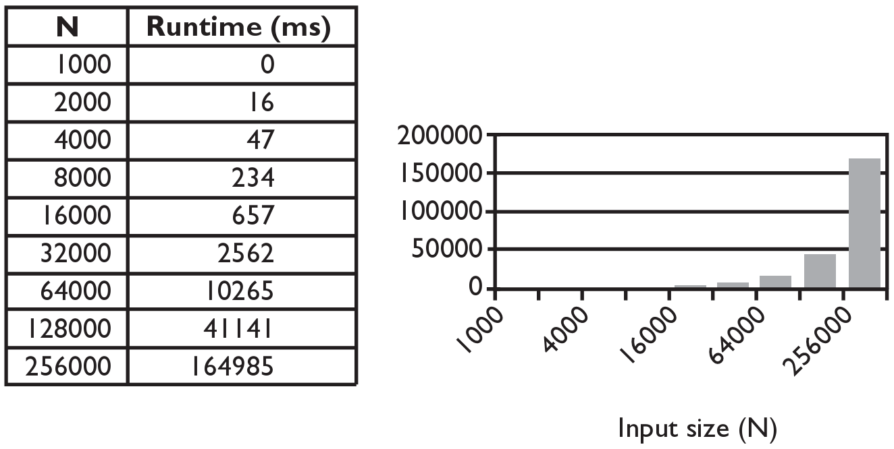
Selection sort runtime (Fig. 13.6)
What is the complexity class (Big-Oh) of selection sort?

Slide 34
Bogo sort
bogo sort: Orders a list of values by repetitively shuffling them and checking if they are sorted.
name comes from the word "bogus"
The algorithm:
Scan the list, seeing if it is sorted. If so, stop.
Else, shuffle the values in the list and repeat.
This sorting algorithm (obviously) has terrible performance!
What is its runtime?

Slide 35
Bogo sort code
// Places the elements of a into sorted order.
public static void bogoSort(int[] a) {
while (!isSorted(a)) {
shuffle(a);
}
}
// Returns true if a's elements are in sorted order.
public static boolean isSorted(int[] a) {
for (int i = 0; i < a.length - 1; i++) {
if (a[i] > a[i + 1]) {
return false;
}
}
return true;
}

Slide 36
Bogo sort code, cont'd.
// Shuffles an array of ints by randomly swapping each
// element with an element ahead of it in the array.
public static void shuffle(int[] a) {
for (int i = 0; i < a.length - 1; i++) {
// pick a random index in [i+1, a.length-1]
int range = a.length - 1 - (i + 1) + 1;
int j = (int) (Math.random() * range + (i + 1));
swap(a, i, j);
}
}
// Swaps a[i] with a[j].
public static void swap(int[] a, int i, int j) {
if (i != j) {
int temp = a[i];
a[i] = a[j];
a[j] = temp;
}
}

Slide 37
Similar algorithms
index | 0 | 1 | 2 | 3 | 4 | 5 | 6 | 7 | 8 | 9 | 10 | 11 | 12 | 13 | 14 | 15 | 16
value | 22 | 18 | 12 | -4 | 27 | 30 | 36 | 50 | 7 | 68 | 91 | 56 | 2 | 85 | 42 | 98 | 25
bubble sort: Make repeated passes, swapping adjacent values
slower than selection sort (has to do more swaps)
insertion sort: Shift each element into a sorted sub-array
faster than selection sort (examines fewer values)
index | 0 | 1 | 2 | 3 | 4 | 5 | 6 | 7 | 8 | 9 | 10 | 11 | 12 | 13 | 14 | 15 | 16
value | 18 | 12 | -4 | 22 | 27 | 30 | 36 | 7 | 50 | 68 | 56 | 2 | 85 | 42 | 91 | 25 | 98
22
50
91
98
index | 0 | 1 | 2 | 3 | 4 | 5 | 6 | 7 | 8 | 9 | 10 | 11 | 12 | 13 | 14 | 15 | 16
value | -4 | 12 | 18 | 22 | 27 | 30 | 36 | 50 | 7 | 68 | 91 | 56 | 2 | 85 | 42 | 98 | 25
sorted sub-array (indexes 0-7)
7

Slide 38
Merge sort
merge sort: Repeatedly divides the data in half, sorts each half, and combines the sorted halves into a sorted whole.
The algorithm:
Divide the list into two roughly equal halves.
Sort the left half.
Sort the right half.
Merge the two sorted halves into one sorted list.
An example of a "divide and conquer" algorithm.
Invented by John von Neumann in 1945

Slide 39
Merge sort example
index | 0 | 1 | 2 | 3 | 4 | 5 | 6 | 7
value | 22 | 18 | 12 | -4 | 58 | 7 | 31 | 42
split
22 | 18 | 12 | -4
58 | 7 | 31 | 42
split
split
22 | 18
12 | -4
58 | 7
31 | 42
split
split
split
split
22
18
12
-4
58
7
31
42
merge
merge
merge
merge
18 | 22
-4 | 12
7 | 58
31 | 42
merge
merge
-4 | 12 | 18 | 22
7 | 31 | 42 | 58
merge
-4 | 7 | 12 | 18 | 22 | 31 | 42 | 58

Slide 40
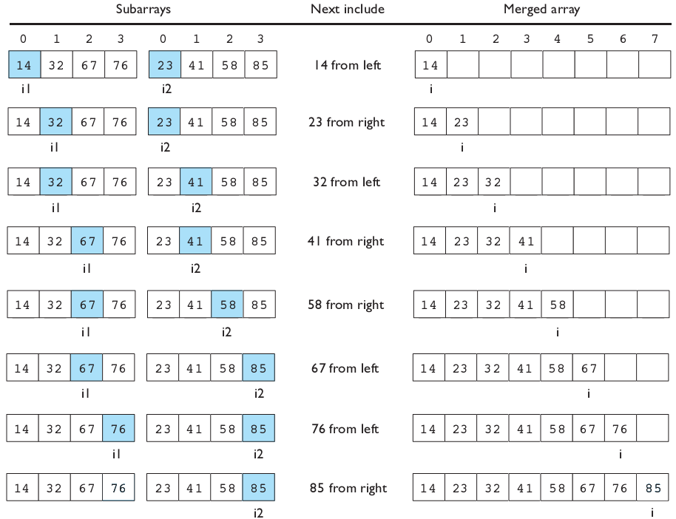
Merging sorted halves

Slide 41
Merge sort
merge sort: Repeatedly divides the data in half, sorts each half, and combines the sorted halves into a sorted whole.
The algorithm:
Divide the list into two roughly equal halves.
Sort the left half.
Sort the right half.
Merge the two sorted halves into one sorted list.
An example of a "divide and conquer" algorithm.
Invented by John von Neumann in 1945

Slide 42
Merge halves code
// Merges the left/right elements into a sorted result.
// Precondition: left/right are sorted
public static void merge(int[] result, int[] left,
int[] right) {
int i1 = 0; // index into left array
int i2 = 0; // index into right array
for (int i = 0; i < result.length; i++) {
if (i2 >= right.length ||
(i1 < left.length && left[i1] <= right[i2])) {
result[i] = left[i1]; // take from left
i1++;
} else {
result[i] = right[i2]; // take from right
i2++;
}
}
}

Slide 43
Merge sort code
// Rearranges the elements of a into sorted order using
// the merge sort algorithm.
public static void mergeSort(int[] a) {
// split array into two halves
int[] left = Arrays.copyOfRange(a, 0, a.length/2);
int[] right = Arrays.copyOfRange(a, a.length/2, a.length);
// sort the two halves
...
// merge the sorted halves into a sorted whole
merge(a, left, right);
}

Slide 44
Merge sort code 2
// Rearranges the elements of a into sorted order using
// the merge sort algorithm (recursive).
public static void mergeSort(int[] a) {
if (a.length >= 2) {
// split array into two halves
int[] left = Arrays.copyOfRange(a, 0, a.length/2);
int[] right = Arrays.copyOfRange(a, a.length/2, a.length);
// sort the two halves
mergeSort(left);
mergeSort(right);
// merge the sorted halves into a sorted whole
merge(a, left, right);
}
}

Slide 45
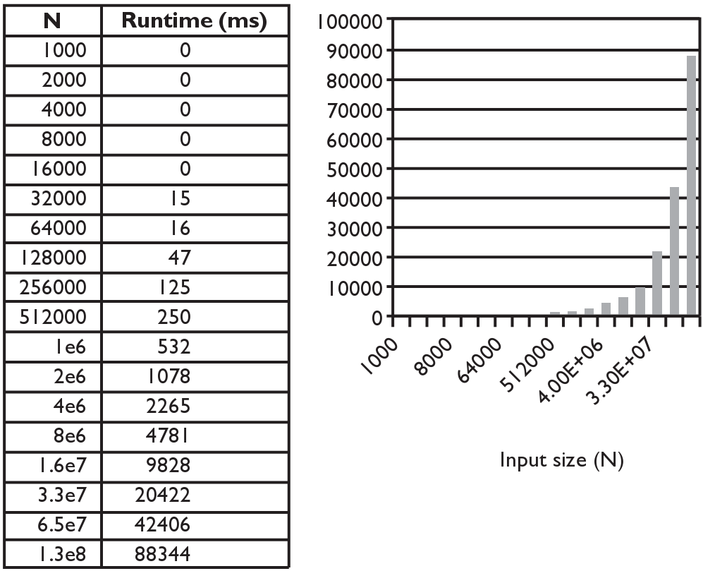
Merge sort runtime
What is the complexity class (Big-Oh) of merge sort?

Slide 46
Building Java Programs
read: 12.5
Recursive backtracking

Slide 47
Exercise: fourAB
Write a method fourAB that prints out all strings of length 4 composed only of a’s and b’s
Example Output
aaaa baaa
aaab baab
aaba baba
aabb babb
abaa bbaa
abab bbab
abba bbba
abbb bbbb

Slide 48
Decision Tree
a
b
…
aa
ab
…
aaa
aab
aaaa
aaab
aaba
aabb

Slide 49

Exercise: Dice rolls
Write a method diceRoll that accepts an integer parameter representing a number of 6-sided dice to roll, and output all possible arrangements of values that could appear on the dice.
diceRoll(2); diceRoll(3);
[1, 1] [1, 2] [1, 3] [1, 4] [1, 5] [1, 6] [2, 1] [2, 2] [2, 3] [2, 4] [2, 5] [2, 6] | [3, 1] [3, 2] [3, 3] [3, 4] [3, 5] [3, 6] [4, 1] [4, 2] [4, 3] [4, 4] [4, 5] [4, 6] | [5, 1] [5, 2] [5, 3] [5, 4] [5, 5] [5, 6] [6, 1] [6, 2] [6, 3] [6, 4] [6, 5] [6, 6]
[1, 1, 1]
[1, 1, 2]
[1, 1, 3]
[1, 1, 4]
[1, 1, 5]
[1, 1, 6]
[1, 2, 1]
[1, 2, 2]
...
[6, 6, 4]
[6, 6, 5]
[6, 6, 6]
Notes:
interesting variation: Output only the *unique* rearrangements. For example, permute("GOOGLE") has two Os, but swapping them in order produces the same string, which shouldn't appear twice in the output.

Slide 50

Examining the problem
We want to generate all possible sequences of values.
for (each possible first die value):
for (each possible second die value):
for (each possible third die value):
...
print!
This is called a depth-first search
How can we completely explore such a large search space?

Slide 51
A decision tree
chosen | available
- | 4 dice
1 | 3 dice
2 | 3 dice
...
1, 1 | 2 dice
1, 2 | 2 dice
1, 3 | 2 dice
1, 4 | 2 dice
...
...
1, 1, 1 | 1 die
1, 1, 2 | 1 die
1, 1, 3 | 1 die
1, 4, 1 | 1 die
...
...
...
1, 1, 1, 1
1, 1, 1, 2
...
1, 1, 3, 1
1, 1, 3, 2
...

Slide 52
Solving recursively
Pick a value for the first die
Recursively find values for the remaining dice
Repeat with other values for the first die
What is the base case?

Slide 53
Private helpers
Often the method doesn't accept the parameters you want.
So write a private helper that accepts more parameters.
Extra params can represent current state, choices made, etc.
public int methodName(params):
...
return helper(params, moreParams);
private int helper(params, moreParams):
...
(use moreParams to help solve the problem)

Slide 54
Exercise solution
// Prints all possible outcomes of rolling the given
// number of six-sided dice in [#, #, #] format.
public static void diceRolls(int dice) {
List<Integer> chosen = new ArrayList<Integer>();
diceRolls(dice, chosen);
}
// private recursive helper to implement diceRolls logic
private static void diceRolls(int dice,
List<Integer> chosen) {
if (dice == 0) {
System.out.println(chosen); // base case
} else {
for (int i = 1; i <= 6; i++) {
chosen.add(i); // choose
diceRolls(dice - 1, chosen); // explore
chosen.remove(chosen.size() - 1); // un-choose
}
}
}

Slide 55
Backtracking
backtracking: Finding solution(s) by trying partial solutions and then abandoning them if they are not suitable.
a "brute force" algorithmic technique (tries all paths)
often implemented recursively
Applications:
producing all permutations of a set of values
parsing languages
games: anagrams, crosswords, word jumbles, 8 queens
combinatorics and logic programming

Slide 56
Backtracking algorithms
A general pseudo-code algorithm for backtracking problems:
Explore(choices):
if there are no more choices to make: stop.
else:
Make a single choice C.
Explore the remaining choices.
Un-make choice C, if necessary. (backtrack!)

Slide 57
Backtracking strategies
When solving a backtracking problem, ask these questions:
What are the "choices" in this problem?
What is the "base case"? (How do I know when I'm out of choices?)
How do I "make" a choice?
Do I need to create additional variables to remember my choices?
Do I need to modify the values of existing variables?
How do I explore the rest of the choices?
Do I need to remove the made choice from the list of choices?
Once I'm done exploring, what should I do?
How do I "un-make" a choice?

Slide 58
Exercise: Dice roll sum
Write a method diceSum similar to diceRoll, but it also accepts a desired sum and prints only arrangements that add up to exactly that sum.
diceSum(2, 7); diceSum(3, 7);
[1, 6]
[2, 5]
[3, 4]
[4, 3]
[5, 2]
[6, 1]
[1, 1, 5]
[1, 2, 4]
[1, 3, 3]
[1, 4, 2]
[1, 5, 1]
[2, 1, 4]
[2, 2, 3]
[2, 3, 2]
[2, 4, 1]
[3, 1, 3]
[3, 2, 2]
[3, 3, 1]
[4, 1, 2]
[4, 2, 1]
[5, 1, 1]

Slide 59
Consider all paths?
chosen | available | desired sum
- | 3 dice | 5
1 | 2 dice
2 | 2 dice
3 | 2 dice
4 | 2 dice
5 | 2 dice
6 | 2 dice
1, 1 | 1 die
1, 2 | 1 die
1, 3 | 1 die
1, 4 | 1 die
1, 5 | 1 die
1, 6 | 1 die
1, 1, 1
1, 1, 2
1, 1, 3
1, 1, 4
1, 1, 5
1, 1, 6
1, 6, 1
1, 6, 2
...

Slide 60
Optimizations
We need not visit every branch of the decision tree.
Some branches are clearly not going to lead to success.
We can preemptively stop, or prune, these branches.
Inefficiencies in our dice sum algorithm:
Sometimes the current sum is already too high.
(Even rolling 1 for all remaining dice would exceed the sum.)
Sometimes the current sum is already too low.
(Even rolling 6 for all remaining dice would not reach the sum.)
When finished, the code must compute the sum every time.
(1+1+1 = ..., 1+1+2 = ..., 1+1+3 = ..., 1+1+4 = ..., ...)

Slide 61
New decision tree
chosen | available | desired sum
- | 3 dice | 5
1 | 2 dice
2 | 2 dice
3 | 2 dice
4 | 2 dice
5 | 2 dice
6 | 2 dice
1, 1 | 1 die
1, 2 | 1 die
1, 3 | 1 die
1, 4 | 1 die
1, 5 | 1 die
1, 6 | 1 die
1, 1, 1
1, 1, 2
1, 1, 3
1, 1, 4
1, 1, 5
1, 1, 6
1, 6, 1
1, 6, 2
...

Slide 62
Exercise: Combinations
Write a method combinations that accepts a string s and an integer k as parameters and outputs all possible k -letter words that can be formed from unique letters in that string. The arrangements may be output in any order.
Example: combinations("GOOGLE", 3) outputs the sequence of lines at right.
To simplify the problem, you may assume that the string s contains at least k unique characters.
EGL EGO ELG ELO EOG EOL GEL GEO GLE GLO GOE GOL | LEG LEO LGE LGO LOE LOG OEG OEL OGE OGL OLE OLG

Slide 63
Initial attempt
public static void combinations(String s, int length) {
combinations(s, "", length);
}
private static void combinations(String s, String chosen, int length) {
if (length == 0) {
System.out.println(chosen); // base case: no choices left
} else {
for (int i = 0; i < s.length(); i++) {
String ch = s.substring(i, i + 1);
if (!chosen.contains(ch)) {
String rest = s.substring(0, i) + s.substring(i + 1);
combinations(rest, chosen + ch, length - 1);
}
}
}
}
Problem: Prints same string multiple times.

Slide 64
Exercise solution
public static void combinations(String s, int length) {
Set<String> all = new TreeSet<String>();
combinations(s, "", all, length);
for (String comb : all) {
System.out.println(comb);
}
}
private static void combinations(String s, String chosen,
Set<String> all, int length) {
if (length == 0) {
all.add(chosen); // base case: no choices left
} else {
for (int i = 0; i < s.length(); i++) {
String ch = s.substring(i, i + 1);
if (!chosen.contains(ch)) {
String rest = s.substring(0, i) + s.substring(i + 1);
combinations(rest, chosen + ch, all, length - 1);
}
}
}
}

Slide 65

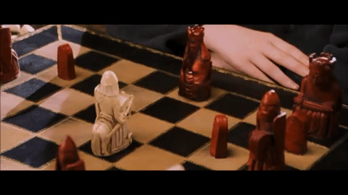

Slide 66
Exercise: Dice roll sum
Write a method diceSum similar to diceRoll, but it also accepts a desired sum and prints only arrangements that add up to exactly that sum.
diceSum(2, 7); diceSum(3, 7);
[1, 6]
[2, 5]
[3, 4]
[4, 3]
[5, 2]
[6, 1]
[1, 1, 5]
[1, 2, 4]
[1, 3, 3]
[1, 4, 2]
[1, 5, 1]
[2, 1, 4]
[2, 2, 3]
[2, 3, 2]
[2, 4, 1]
[3, 1, 3]
[3, 2, 2]
[3, 3, 1]
[4, 1, 2]
[4, 2, 1]
[5, 1, 1]

Slide 67
Consider all paths?
chosen | available | desired sum
- | 3 dice | 5
1 | 2 dice
2 | 2 dice
3 | 2 dice
4 | 2 dice
5 | 2 dice
6 | 2 dice
1, 1 | 1 die
1, 2 | 1 die
1, 3 | 1 die
1, 4 | 1 die
1, 5 | 1 die
1, 6 | 1 die
1, 1, 1
1, 1, 2
1, 1, 3
1, 1, 4
1, 1, 5
1, 1, 6
1, 6, 1
1, 6, 2
...

Slide 68
Optimizations
We need not visit every branch of the decision tree.
Some branches are clearly not going to lead to success.
We can preemptively stop, or prune, these branches.
Inefficiencies in our dice sum algorithm:
Sometimes the current sum is already too high.
(Even rolling 1 for all remaining dice would exceed the sum.)
Sometimes the current sum is already too low.
(Even rolling 6 for all remaining dice would not reach the sum.)
When finished, the code must compute the sum every time.
(1+1+1 = ..., 1+1+2 = ..., 1+1+3 = ..., 1+1+4 = ..., ...)

Slide 69
New decision tree
chosen | available | desired sum
- | 3 dice | 5
1 | 2 dice
2 | 2 dice
3 | 2 dice
4 | 2 dice
5 | 2 dice
6 | 2 dice
1, 1 | 1 die
1, 2 | 1 die
1, 3 | 1 die
1, 4 | 1 die
1, 5 | 1 die
1, 6 | 1 die
1, 1, 1
1, 1, 2
1, 1, 3
1, 1, 4
1, 1, 5
1, 1, 6
1, 6, 1
1, 6, 2
...

Slide 70
The "8 Queens" problem
Consider the problem of trying to place 8 queens on a chess board such that no queen can attack another queen.
What are the "choices"?
How do we "make" or "un-make" a choice?
How do we know when to stop?
Q
 |  |  |  |  | Q
 |  |  |  |  |  |  | Q
 |  | Q
 |  |  |  |  |  | Q
 |  |  | Q
 | Q
 |  |  |  | Q

Slide 71
Naive algorithm
for (each square on board):
Place a queen there.
Try to place the rest of the queens.
Un-place the queen.
How large is the solution space for this algorithm?
64 * 63 * 62 * ...
 | 1 | 2 | 3 | 4 | 5 | 6 | 7 | 8
1 | Q | ... | ... | ... | ... | ... | ... | ...
2 | ... | ... | ... | ... | ... | ... | ... | ...
3 | ...
4
5
6
7
8

Slide 72
Better algorithm idea
Observation: In a working solution, exactly 1 queen must appear in each row and in each column.
Redefine a "choice" to be valid placement of a queen in a particular column.
How large is the solution space now?
8 * 8 * 8 * ...
 | 1 | 2 | 3 | 4 | 5 | 6 | 7 | 8
1 | Q | ... | ...
2 |  | ... | ...
3 |  | Q | ...
4 |  |  | ...
5 |  |  | Q
6
7
8

Slide 73
Recall: Backtracking
A general pseudo-code algorithm for backtracking problems:
Explore(choices):
if there are no more choices to make: stop.
else, for each available choice C:
Choose C.
Explore the remaining choices.
Un-choose C, if necessary. (backtrack!)

Slide 74
Exercise
Suppose we have a Board class with these methods:
Write a method solve that accepts a Board as a parameter and tries to place 8 queens on it safely.
Your method should find all solutions.
Method/Constructor | Description
public Board(int size) | construct empty board
public boolean safe(int row, int column) | true if queen can be safely placed here
public void place(int row, int column) | place queen here
public void remove(int row, int column) | remove queen from here
public void print() | displays the board

Slide 75
Building Java Programs
Generics, hashing
reading: 18.1

Slide 76
Hashing
hash: To map a value to an integer index.
hash table: An array that stores elements via hashing.
hash function: An algorithm that maps values to indexes.
one possible hash function for integers: HF(I) = I % length
set.add(11); // 11 % 10 == 1
set.add(49); // 49 % 10 == 9
set.add(24); // 24 % 10 == 4
set.add(7); // 7 % 10 == 7
index | 0 | 1 | 2 | 3 | 4 | 5 | 6 | 7 | 8 | 9
value | 0 | 11 | 0 | 0 | 24 | 0 | 0 | 7 | 0 | 49

Slide 77
Efficiency of hashing
public static int hashFunction(int i) {
return Math.abs(i) % elementData.length;
}
Add: set elementData[HF(i)] = i;
Search: check if elementData[HF(i)] == i
Remove: set elementData[HF(i)] = 0;
What is the runtime of add, contains, and remove?
O(1)
Are there any problems with this approach?

Slide 78
Hash Functions
Maps an object to a number
result should be constrained to some range
passing in the same object should always give the same result
Results from a hash function should be distributed over a range
very bad if everything hashes to 1!
should "look random"
How would we write a hash function for String objects?
Notes:
first letter? length of word? Sum of ASCII values?

Slide 79
Hashing objects
It is easy to hash an integer I (use index I % length ).
How can we hash other types of values (such as objects)?
All Java objects contain the following method:
public int hashCode()
Returns an integer hash code for this object.
We can call hashCode on any object to find its preferred index.
How is hashCode implemented?
Depends on the type of object and its state.
Example: a String's hashCode adds the ASCII values of its letters.
You can write your own hashCode methods in classes you write.
All classes come with a default version based on memory address.

Slide 80
Hash function for objects
public static int hashFunction(E e) {
return Math.abs(e.hashCode()) % elements.length;
}
Add: set elements[HF(o)] = o;
Search: check if elements[HF(o)].equals(o)
Remove: set elements[HF(o)] = null;

Slide 81
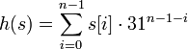
String's hashCode
The hashCode function inside String objects looks like this:
public int hashCode() {
int hash = 0;
for (int i = 0; i < this.length(); i++) {
hash = 31 * hash + this.charAt(i);
}
return hash;
}
As with any general hashing function, collisions are possible.
Example: "Ea" and "FB" have the same hash value.
Early versions of Java examined only the first 16 characters. For some common data this led to poor hash table performance.

Slide 82


Slide 83
Implementing generics
// a parameterized (generic) class
public class name<TypeParameter> {
...
}
Forces any client that constructs your object to supply a type.
Don't write an actual type such as String; the client does that.
Instead, write a type variable name such as E (for "element") or T (for "type").
You can require multiple type parameters separated by commas.
The rest of your class's code can refer to that type by name.

Slide 84
Collisions
collision: When hash function maps 2 values to same index.
set.add(11);
set.add(49);
set.add(24);
set.add(7);
set.add(54); // collides with 24!
collision resolution: An algorithm for fixing collisions.
index | 0 | 1 | 2 | 3 | 4 | 5 | 6 | 7 | 8 | 9
value | 0 | 11 | 0 | 0 | 54 | 0 | 0 | 7 | 0 | 49

Slide 85
Probing
probing: Resolving a collision by moving to another index.
linear probing: Moves to the next index.
set.add(11);
set.add(49);
set.add(24);
set.add(7);
set.add(54); // collides with 24; must probe
Is this a good approach?
variation: quadratic probing moves increasingly far away
index | 0 | 1 | 2 | 3 | 4 | 5 | 6 | 7 | 8 | 9
value | 0 | 11 | 0 | 0 | 24 | 54 | 0 | 7 | 0 | 49

Slide 86
Clustering
clustering: Clumps of elements at neighboring indexes.
slows down the hash table lookup; you must loop through them.
set.add(11);
set.add(49);
set.add(24);
set.add(7);
set.add(54); // collides with 24
set.add(14); // collides with 24, then 54
set.add(86); // collides with 14, then 7
How many indexes must a lookup for 94 visit?
index | 0 | 1 | 2 | 3 | 4 | 5 | 6 | 7 | 8 | 9
value | 0 | 0 | 0 | 0 | 0 | 0 | 0 | 0 | 0 | 0
index | 0 | 1 | 2 | 3 | 4 | 5 | 6 | 7 | 8 | 9
value | 0 | 11 | 0 | 0 | 24 | 54 | 14 | 7 | 86 | 49
Notes:
Now a lookup for 94 must look at 7 out of 10 total indexes.

Slide 87
Chaining
chaining: Resolving collisions by storing a list at each index.
add/search/remove must traverse lists, but the lists are short
impossible to "run out" of indexes, unlike with probing
index | 0 | 1 | 2 | 3 | 4 | 5 | 6 | 7 | 8 | 9
value
11
24
7
49
54
14

Slide 88
Hash set code
import java.util.*; // for List, LinkedList
public class HashIntSet {
private static final int CAPACITY = 137;
private List<Integer>[] elements;
// constructs new empty set
public HashSet() {
elements = (List<Integer>[]) (new List[CAPACITY]);
}
// adds the given value to this hash set
public void add(int value) {
int index = hashFunction(value);
if (elements[index] == null) {
elements[index] = new LinkedList<Integer>();
}
elements[index].add(value);
}
// hashing function to convert objects to indexes
private int hashFunction(int value) {
return Math.abs(value) % elements.length;
}
...

Slide 89
Hash set code 2
...
// Returns true if this set contains the given value.
public boolean contains(int value) {
int index = hashFunction(value);
return elements[index] != null &&
elements[index].contains(value);
}
// Removes the given value from the set, if it exists.
public void remove(int value) {
int index = hashFunction(value);
if (elements[index] != null) {
elements[index].remove(value);
}
}
}

Slide 90
Rehashing
rehash: Growing to a larger array when the table is too full.
Cannot simply copy the old array to a new one. (Why not?)
load factor: ratio of (# of elements ) / (hash table length )
many collections rehash when load factor ≅ .75
can use big prime numbers as hash table sizes to reduce collisions
0 | 1 | 2 | 3 | 4 | 5 | 6 | 7 | 8 | 9 | 10 | 11 | 12 | 13 | 14 | 15 | 16 | 17 | 18 | 19
24
7
49
11
54
14

Slide 91
Rehashing code
...
// Grows hash array to twice its original size.
private void rehash() {
List<Integer>[] oldElements = elements;
elements = (List<Integer>[])
new List[2 * elements.length];
for (List<Integer> list : oldElements) {
if (list != null) {
for (int element : list) {
add(element);
}
}
}
}

Slide 92
Other questions
How would we implement toString on a HashSet?
index | 0 | 1 | 2 | 3 | 4 | 5 | 6 | 7 | 8 | 9
value
11
24
7
49
54
current element: 24
current index: 4
sub-index: 0
iterator
14

Slide 93
Implementing a hash map
A hash map is just a set where the lists store key/value pairs:
// key value
map.put("Marty", 14);
map.put("Jeff", 21);
map.put("Kasey", 20);
map.put("Stef", 35);
Instead of a List<Integer>, write an inner Entry node class with key and value fields; the map stores a List<Entry>
index | 0 | 1 | 2 | 3 | 4 | 5 | 6 | 7 | 8 | 9
value
"Stef" | 35
"Marty" | 14
"Jeff" | 21
"Kasey" | 20

Slide 94
Building Java Programs
Binary Trees
reading: 17.1 – 17.3

Slide 95
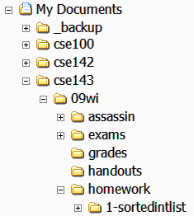
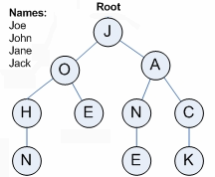
Trees in computer science
TreeMap and TreeSet implementations
folders/files on a computer
family genealogy; organizational charts
AI: decision trees
compilers: parse tree
a = (b + c) * d;
cell phone T9
=
a
*
+
d
b
c

Slide 96
Trees
tree: A directed, acyclic structure of linked nodes.
directed : Has one-way links between nodes.
acyclic : No path wraps back around to the same node twice.
binary tree: One where each node has at most two children.
Recursive definition: A tree is either:
empty (null), or
a root node that contains:
data,
a left subtree, and
a right subtree.
(The left and/or right subtree could be empty.)
root
1
2
3
4
5
6
7
Notes:
The definition of a tree shown here is recursive.

Slide 97
Recursive data structure
Recursive definition: A tree is either:
empty (null), or
a root node that contains:
data,
a left tree, and
a right tree
root
root
root
root
root
1
1
1
1
2
3
3
7

Slide 98
Terminology
node: an object containing a data value and left/right children
root: topmost node of a tree
leaf: a node that has no children
branch: any internal node; neither the root nor a leaf
parent: a node that refers to this one
child: a node that this node refers to
sibling: a node with a common parent
subtree: the smaller tree of nodes on the left or right of the current node
height: length of the longest path from the root to any node
level or depth: length of the path from a root to a given node
root
height = 3
level 1
1
level 2
2
3
4
5
6
7
level 3

Slide 99
A tree node for integers
A basic tree node object stores data, refers to left/right
Multiple nodes can be linked together into a larger tree
left | data | right
 | 42
left | data | right
 | 59
left | data | right
 | 27
left | data | right
 | 86
Notes:
Would it be useful to have a trinary tree? An N-ary tree?
Yes, for some applications. A T9 cell phone typing algorithm uses a 26-ary "prefix tree" or "Trie". Databases often use N-ary trees for indexing for speed. But we can do a lot with just two links.

Slide 100
IntTreeNode class
// An IntTreeNode object is one node in a binary tree of ints.
public class IntTreeNode {
public int data; // data stored at this node
public IntTreeNode left; // reference to left subtree
public IntTreeNode right; // reference to right subtree
// Constructs a leaf node with the given data.
public IntTreeNode(int data) {
this(data, null, null);
}
// Constructs a branch node with the given data and links.
public IntTreeNode(int data, IntTreeNode left,
IntTreeNode right) {
this.data = data;
this.left = left;
this.right = right;
}
}
left | data | right

Slide 101
IntTree class
// An IntTree object represents an entire binary tree of ints.
public class IntTree {
private IntTreeNode overallRoot; // null for an empty tree
methods
}
Client code talks to the IntTree, not to the node objects inside it.
Methods of the IntTree create and manipulate the nodes, their data and links between them.
overallRoot
1
2
3
4
5
6
7

Slide 102
Print IntTree
We want to write a method that prints out the contents of an IntTree.
Here is the output we want
17 41 29 6 9 81 40
overallRoot
17
private void print(IntTreeNode root) {
if (root != null) {
System.out.print(root.data + " ");
print(root.left);
print(root.right);
}
}
41
9
29
6
81
40

Slide 103
Traversals
Orderings for traversals
pre-order: process root node, then its left/right subtrees
in-order: process left subtree, then root node, then right
post-order: process left/right subtrees, then root node
pre-order: 17 41 29 6 9 81 40
private void print(IntTreeNode root) {
if (root != null) {
System.out.print(root.data + " ");
print(root.left);
print(root.right);
}
}
overallRoot
17
41
9
29
6
81
40

Slide 104
Traversals
Orderings for traversals
pre-order: process root node, then its left/right subtrees
in-order: process left subtree, then root node, then right
post-order: process left/right subtrees, then root node
in-order: 29 41 6 17 81 9 40
private void print(IntTreeNode root) {
if (root != null) {
print(root.left);
System.out.print(root.data + " ");
print(root.right);
}
}
overallRoot
17
41
9
29
6
81
40

Slide 105
Traversals
Orderings for traversals
pre-order: process root node, then its left/right subtrees
in-order: process left subtree, then root node, then right
post-order: process left/right subtrees, then root node
post-order: 29 6 41 81 40 9 17
private void print(IntTreeNode root) {
if (root != null) {
print(root.left);
print(root.right);
System.out.print(root.data + " ");
}
}
overallRoot
17
41
9
29
6
81
40

Slide 106
Exercise
overallRoot
Give pre-, in-, and post-order traversals for the following tree:
pre: 42 15 27 48 9 86 12 5 3 39
in: 15 48 27 42 86 5 12 9 3 39
post: 48 27 15 5 12 86 39 3 42
42
15
9
27
86
3
48
12
39
5

Slide 107
Traversal trick
overallRoot
To quickly generate a traversal:
Trace a path around the tree.
As you pass a node on the proper side, process it.
pre-order: left side
in-order: bottom
post-order: right side
pre-order: 17 41 29 6 9 81 40
in-order: 29 41 6 17 81 9 40
post-order: 29 6 41 81 40 9 17
17
41
9
29
6
81
40

Slide 108
Exercise
Add a method contains to the IntTree class that searches the tree for a given integer, returning true if it is found.
If an IntTree variable tree referred to the tree below, the following calls would have these results:
tree.contains(87) → true
tree.contains(60) → true
tree.contains(63) → false
tree.contains(42) → false
overallRoot
55
87
29
-3
42
60
60

Slide 109
Exercise solution
// Returns whether this tree contains the given integer.
public boolean contains(int value) {
return contains(overallRoot, value);
}
private boolean contains(IntTreeNode node, int value) {
if (node == null) {
return false; // base case: not found here
} else if (node.data == value) {
return true; // base case: found here
} else {
// recursive case: search left/right subtrees
return contains(node.left, value) ||
contains(node.right, value);
}
}

Slide 110
Template for tree methods
public class IntTree {
private IntTreeNode overallRoot;
...
public type name(parameters) {
name(overallRoot, parameters);
}
private type name(IntTreeNode root, parameters) {
...
}
}
Tree methods are often implemented recursively
with a public/private pair
the private version accepts the root node to process

Slide 111
Building Java Programs
Binary Search Trees
reading: 17.3 – 17.4

Slide 112
Binary search trees
binary search tree ("BST"): a binary tree where each non-empty node R has the following properties:
elements of R's left subtree contain data "less than" R's data,
elements of R's right subtree contain data "greater than" R's,
R's left and right subtrees are also binary search trees.
BSTs store their elements in sorted order, which is helpful for searching/sorting tasks.
overall root
55
29
87
-3
42
60
91

Slide 113
BST examples
Which of the trees shown are legal binary search trees?
m
-5
42
8
g
q
-1
-7
5
11
b
k
x
2
7
10
18
7.2
e
4
20
1.9
9.6
18
8.1
21.3

Slide 114
Searching a BST
Describe an algorithm for searching a binary search tree.
Try searching for the value 31, then 6.
What is the maximum number of nodes you would need to examine to perform any search?
overall root
18
12
35
4
15
22
58
-2
7
13
16
19
31
40
87

Slide 115
Exercise
Convert the IntTree class into a SearchTree class.
The elements of the tree will form a legal binary search tree.
Write a contains method that takes advantage of the BST structure.
tree.contains(29) → true
tree.contains(55) → true
tree.contains(63) → false
tree.contains(35) → false
overall root
55
29
87
-3
42
60
91

Slide 116
Exercise solution
// Returns whether this BST contains the given integer.
public boolean contains(int value) {
return contains(overallRoot, value);
}
private boolean contains(IntTreeNode node, int value) {
if (node == null) {
return false; // base case: not found here
} else if (node.data == value) {
return true; // base case: found here
} else if (node.data > value) {
return contains(node.left, value);
} else { // root.data < value
return contains(node.right, value);
}
}

Slide 117
Adding to a BST
Suppose we want to add new values to the BST below.
Where should the value 14 be added?
Where should 3 be added? 7?
If the tree is empty, where should a new value be added?
What is the general algorithm?
overall root
8
5
11
2
7
10
19
4
25
22

Slide 118
Adding exercise
Draw what a binary search tree would look like if the following values were added to an initially empty tree in this order:
50
20
75
98
80
31
150
39
23
11
77
50
20
75
11
31
98
23
39
80
150
77

Slide 119
Exercise
Add a method add to the SearchTree class that adds a given integer value to the BST.
Add the new value in the proper place to maintain BST ordering.
tree.add(49);
overall root
55
29
87
-3
42
60
91
49

Slide 120
An incorrect solution
// Adds the given value to this BST in sorted order.
public void add(int value) {
add(overallRoot, value);
}
private void add(IntTreeNode node, int value) {
if (node == null) {
node = new IntTreeNode(value);
} else if (node.data > value) {
add(node.left, value);
} else if (node.data < value) {
add(node.right, value);
}
// else node.data == value, so
// it's a duplicate (don't add)
}
Why doesn't this solution work?
overallRoot
55
29
87
-3
42
60
91

Slide 121
The x = change(x) pattern
read 17.3

Slide 122
A tangent: Change a point
What is the state of the object referred to by p after this code?
public static void main(String[] args) {
Point p = new Point(1, 2);
change(p);
System.out.println(p);
}
public static void change(Point thePoint) {
thePoint.x = 3;
thePoint.y = 4;
}
// answer: (3, 4)
p
x
1
y
2

Slide 123
Change point, version 2
What is the state of the object referred to by p after this code?
public static void main(String[] args) {
Point p = new Point(1, 2);
change(p);
System.out.println(p);
}
public static void change(Point thePoint) {
thePoint = new Point(3, 4);
}
// answer: (1, 2)
p
x
1
y
2
x
3
y
4

Slide 124
Changing references
If a method dereferences a variable (with . ) and modifies the object it refers to, that change will be seen by the caller.
public static void change(Point thePoint) {
thePoint.x = 3; // affects p
thePoint.setY(4); // affects p
If a method reassigns a variable to refer to a new object, that change will not affect the variable passed in by the caller.
public static void change(Point thePoint) {
thePoint = new Point(3, 4); // p unchanged
thePoint = null; // p unchanged
What if we want to make the variable passed in become null?

Slide 125
Change point, version 3
What is the state of the object referred to by p after this code?
public static void main(String[] args) {
Point p = new Point(1, 2);
change(p);
System.out.println(p);
}
public static Point change(Point thePoint) {
thePoint = new Point(3, 4);
return thePoint;
}
// answer: (1, 2)
p
x
1
y
2
x
3
y
4

Slide 126
Change point, version 4
What is the state of the object referred to by p after this code?
public static void main(String[] args) {
Point p = new Point(1, 2);
p = change(p);
System.out.println(p);
}
public static Point change(Point thePoint) {
thePoint = new Point(3, 4);
return thePoint;
}
// answer: (3, 4)
p
x
1
y
2
x
3
y
4

Slide 127
x = change(x);
If you want to write a method that can change the object that a variable refers to, you must do three things:
1. pass in the original state of the object to the method
2. return the new (possibly changed) object from the method
3. re-assign the caller's variable to store the returned result
p = change(p); // in main
public static Point change(Point thePoint) {
thePoint = new Point(99, -1);
return thePoint;
We call this general algorithmic pattern x = change(x);
also seen with strings: s = s.toUpperCase();

Slide 128
The problem
Much like with linked lists, if we just modify what a local variable refers to, it won't change the collection.
private void add(IntTreeNode node, int value) {
if (node == null) {
node = new IntTreeNode(value);
}
In the linked list case, how did we actually modify the list?
by changing the front
by changing a node's next field
node
49
overallRoot
55
29
87
-3
42
60
91

Slide 129
Applying x = change(x)
Methods that modify a tree should have the following pattern:
input (parameter): old state of the node
output (return): new state of the node
In order to actually change the tree, you must reassign:
node = change(node, parameters);
node.left = change(node.left, parameters);
node.right = change(node.right, parameters);
overallRoot = change(overallRoot, parameters);
node
before
parameter
your
method
return
node
after

Slide 130
A correct solution
// Adds the given value to this BST in sorted order.
public void add(int value) {
overallRoot = add(overallRoot, value);
}
private IntTreeNode add(IntTreeNode node, int value) {
if (node == null) {
node = new IntTreeNode(value);
} else if (node.data > value) {
node.left = add(node.left, value);
} else if (node.data < value) {
node.right = add(node.right, value);
} // else a duplicate; do nothing
return node;
}
What happens when node is a leaf?
overallRoot
55
29
87
-3
42
60
91
Notes:
What about the case where root is unmodified?

